Slide 1
The theft package
for R
Trent Henderson | 16 July 2022

Slide 2
Today’s talk
01
Software landscape
02
The theft package for R
03
Future directions
04
Post-talk tutorial

Slide 3
Software landscape

Slide 4
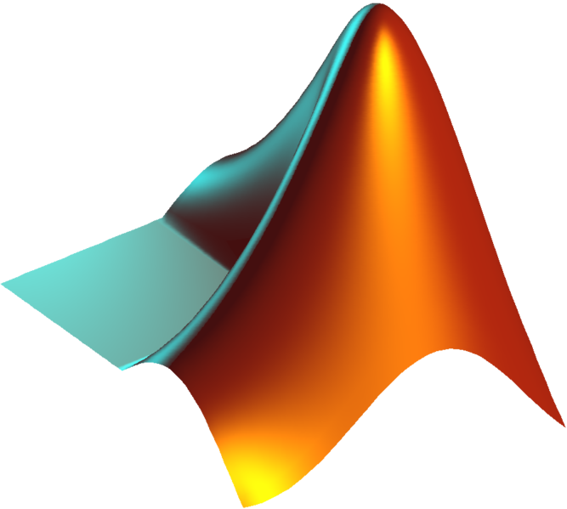




Numerous open-source packages for feature extraction exist…
catch22 (pycatch22)
Kats
TSFEL
tsfresh
catch22
catch22 (Rcatch22)
feasts
tsfeatures
catch22 (Catch22.jl)
Do science!

Slide 5
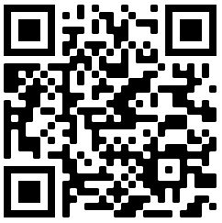
…And they differ considerably…
Key takeaways
Computation time varies over orders of magnitudes
Within-set redundancy is high for tsfresh and TSFEL
Correlations were identified between feature sets, with tsfresh being the most “unique”
Henderson, T., & Fulcher, B. D. (2021). An Empirical Evaluation of Time-Series Feature Sets. 2021 International Conference on Data Mining Workshops, 1032-1038

Slide 6
…And they differ considerably…
Henderson, T., & Fulcher, B. D. (2021). An Empirical Evaluation of Time-Series Feature Sets. 2021 International Conference on Data Mining Workshops, 1032-1038

Slide 7

…Which raises many questions
I have a large fMRI dataset, what feature set do I use?
Kats is a new feature set, how is it related to existing sets?
catch22 seems fast, does feasts add useful information on top of it?
I don’t know what temporal dynamics best distinguish my classes, what feature set(s) should I use?

Slide 8
The theft package for R

Slide 9
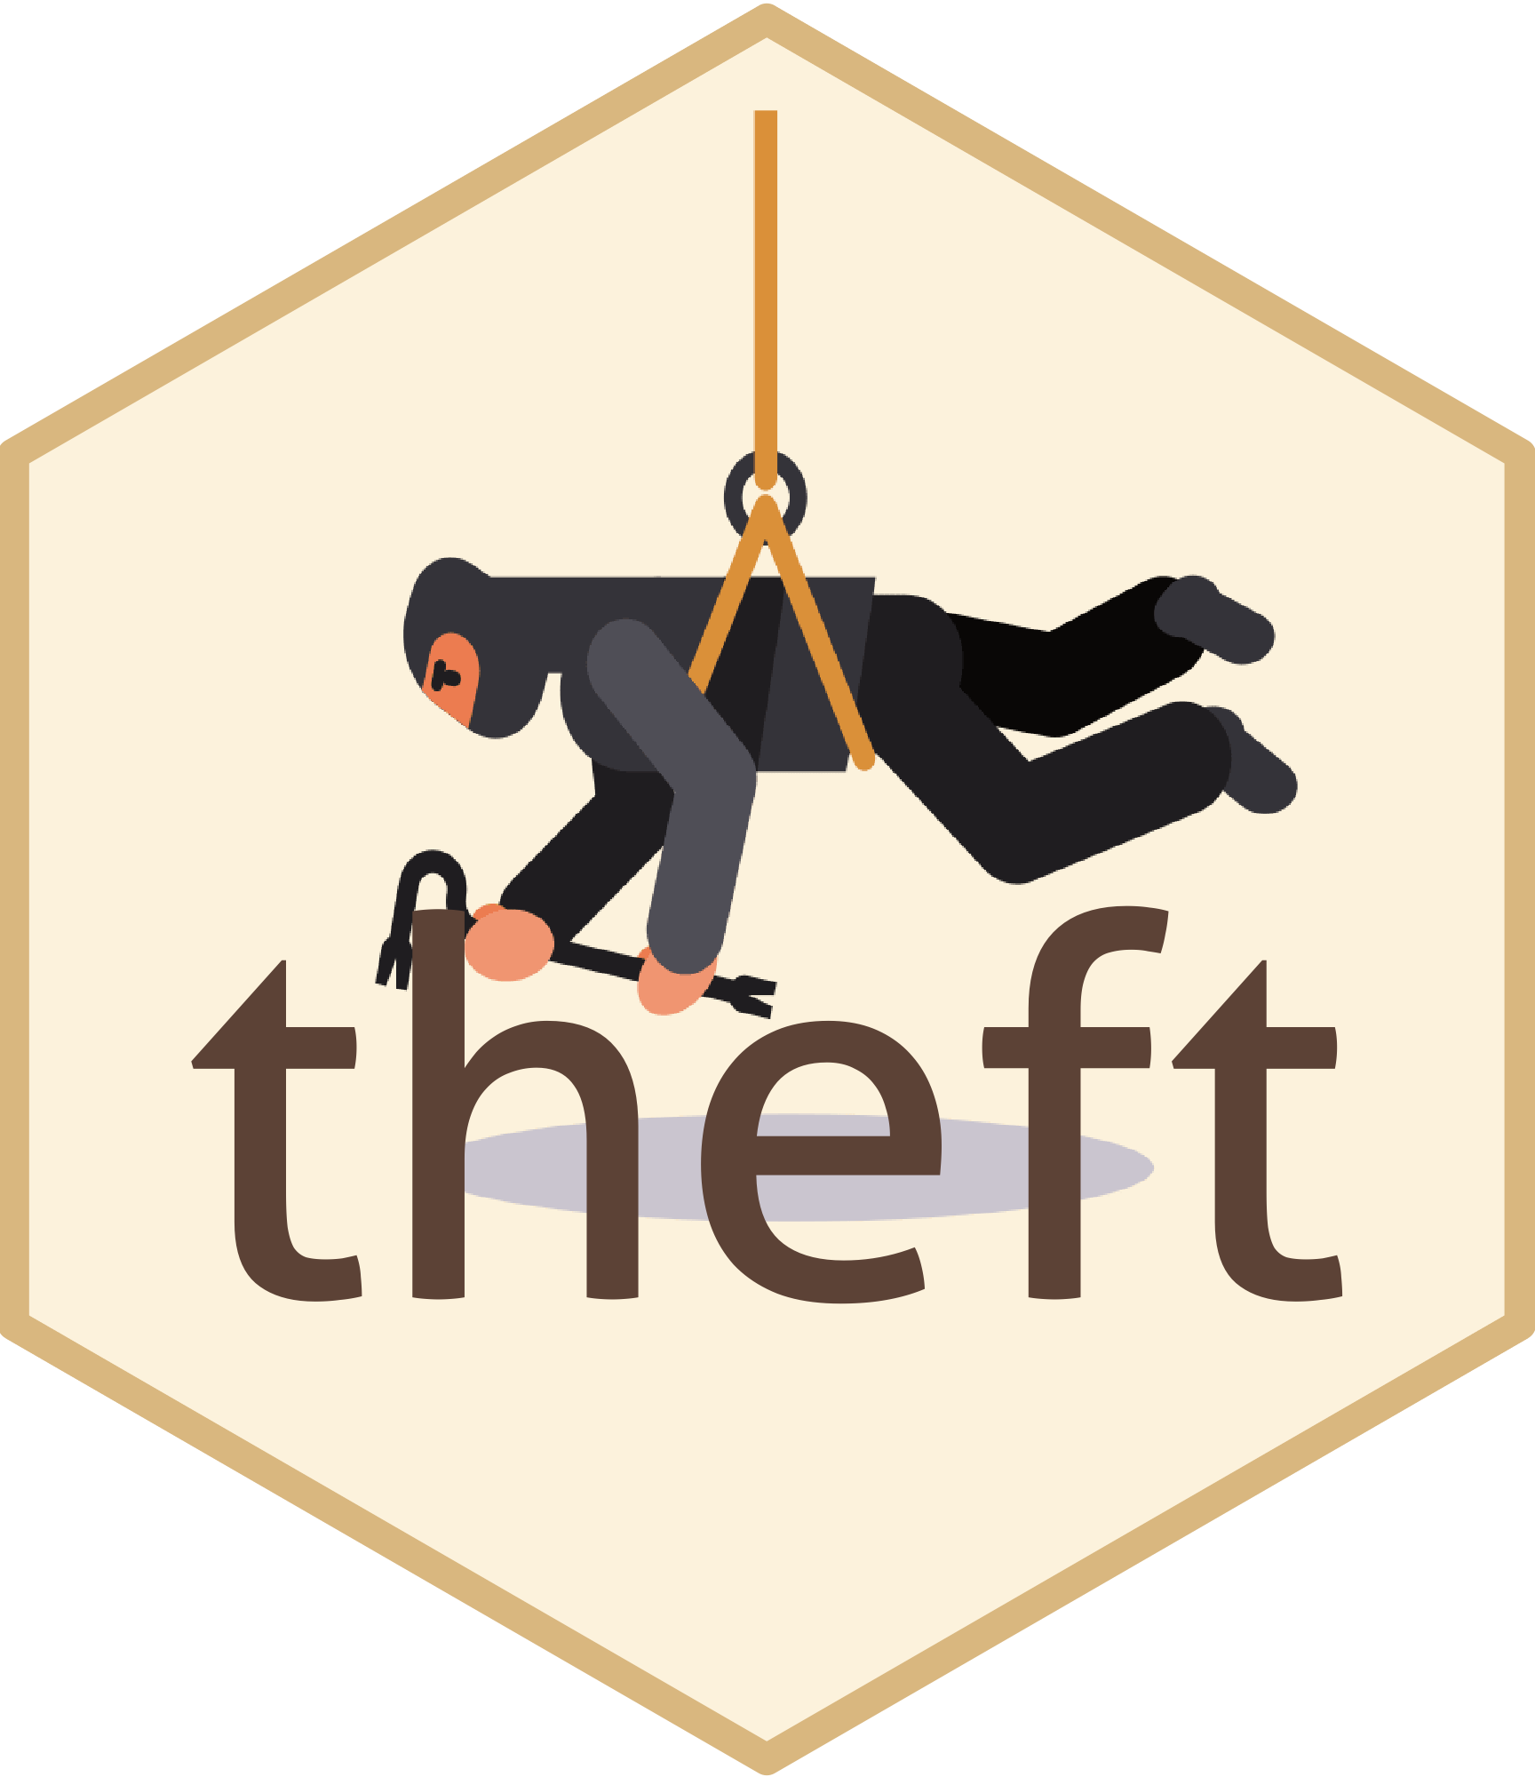
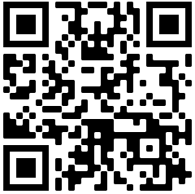
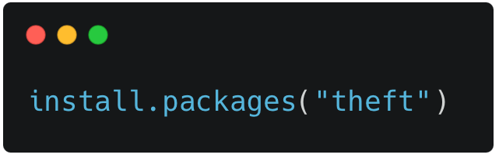
theft
Tools for Handling Extraction of Features from Time series
The time series software package you never knew you needed
theft is a unified and extendable framework for computing features from six open-source sets from both R and Python.
It also includes a suite of functions for processing and interpreting the performance of extracted features, with extensive data-visualization templates, low-dimensional projections, and fitting and evaluation of feature-based classifiers.

Slide 10
theft extracts features from six libraries in one convenient package
catch22
Kats
R, 22 features
Python, 40 features
feasts
TSFEL
R, 42 features
Python, 390 features
tsfeatures
tsfresh
R, 63 features
Python, 779 features

Slide 11
And provides an extensive workflow for feature-based time-series analysis

Slide 12
Future directions

Slide 13
theft is flexible and extensible
Now
Now
Future
Future
Continuous development & application
Current release
Applying theft
Fixing issues
Adding sets
Making sets
I am currently applying theft to problems across neuroscience, machine learning, and more!
I am currently logging issues of my own as I apply theft and fixing those logged by others
As new, more powerful features and sets are developed, they can be added to theft
theft currently calculates >1200 features, creating an opportunity to make reduced feature sets
Please feel free to contribute!
You can find the theft source code on GitHub: https://github.com/hendersontrent/theft
A website with a rendered vignette of functionality is available: https://hendersontrent.github.io/theft/

Slide 14
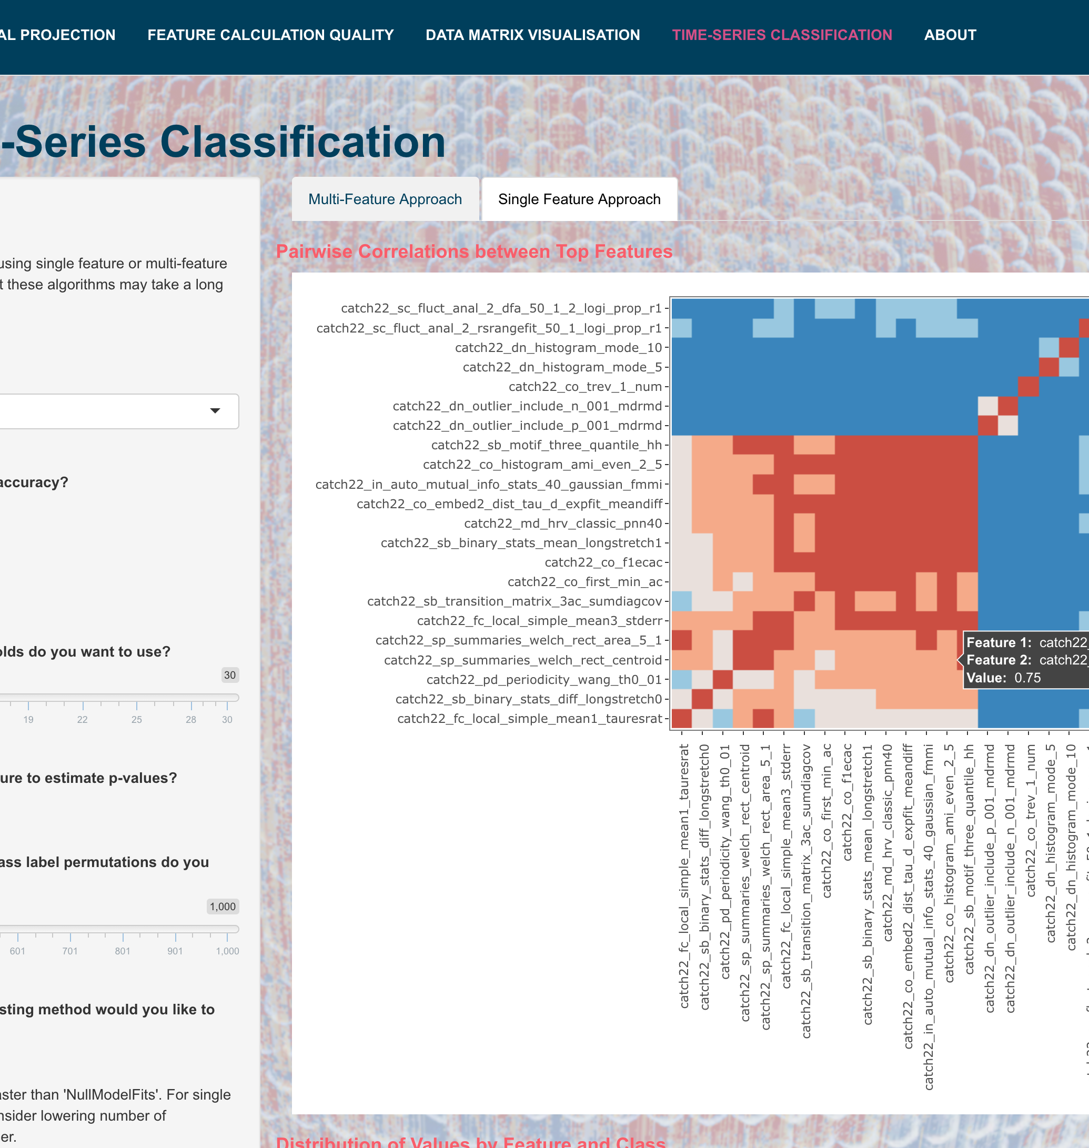
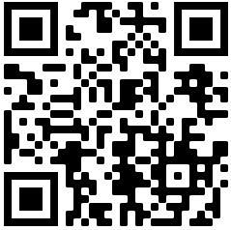
See you later for the theft demo!
Resources for the demo:
https://github.com/hendersontrent/CNS-2022-theft

Slide 15




Thanks for listening!
Feel free to get in touch:
then6675@uni.sydney.edu.au
https://github.com/hendersontrent
@trentlikesstats
https://www.linkedin.com/in/trent-henderson/
Some of my software packages:

